Slide 1

BSBXCS404 – Contribute to cyber security risk management

Slide 2
Elements and Performance criteria
1. Contribute to recommending risk management strategies that mitigate cyber security risk.
1.1 Consult with stakeholders to determine scope of risk management appropriate to organisation and industry
1.2 Review relevant critical cyber risk management strategies appropriate to level of risk
1.3 Assist in developing suitable cyber security response options according to organisational policies and procedures
1.4 Present options for risk management strategies for approval within scope of own role
1.5 Document approved risk management strategies

Slide 3
Elements and Performance criteria
2. Support implementation of approved risk management strategies in response to risk.
2.1 Support communication of approved risk management strategies to required personnel
2.2 Contribute to monitoring cyber security risk according to selected risk management strategies
2.3 Assist in determining compliance with implemented cyber risk mitigation strategies
2.4 Address non-compliance within scope of own role and escalate where required according to organisational policies and procedures
2.5 Assist in establishing feedback processes that provide warning of potential new risks according to organisational requirements

Slide 4
Elements and Performance criteria
3. 3. Review and revise implemented risk management strategies.
3.1 Identify benchmarks to track effectiveness of risk management strategies
3.2 Support evaluation of effectiveness of implemented strategies
3.3 Update risk management strategies with new information as required

Slide 5

Overview
Cyber security
What does cyber security mean?
Why cyber security is getting more challenging?

Slide 6
What is Cyber Security?
Cyber security refers to the body of technologies, processes, and practices designed to protect networks, devices, programs, and data from attack, damage, or unauthorized access. Cyber security may also be referred to as information technology security. This also includes responding to cyber incidents.
The aim of cyber security is to maintain the CIA triad of information.

Slide 7
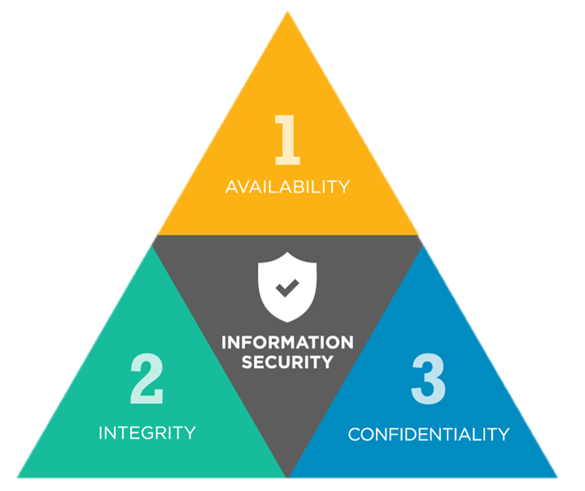
The CIA Triad of cyber security

Slide 8
5 Reasons Why cyber security is getting more challenging?
1. The rising cost of breaches
2. Increasingly sophisticated hackers
3. Widely available hacking tools
4. A proliferation of IoT devices
5. Tighter regulations

Slide 9
What is Risk Management?
The process of determining the maximum acceptable level of overall risk to and from a proposed activity, then using risk assessment techniques to determine the initial level of risk and, if this is excessive, developing a strategy to manage appropriate risks until the overall level of risk is reduced to an acceptable level.

Slide 10
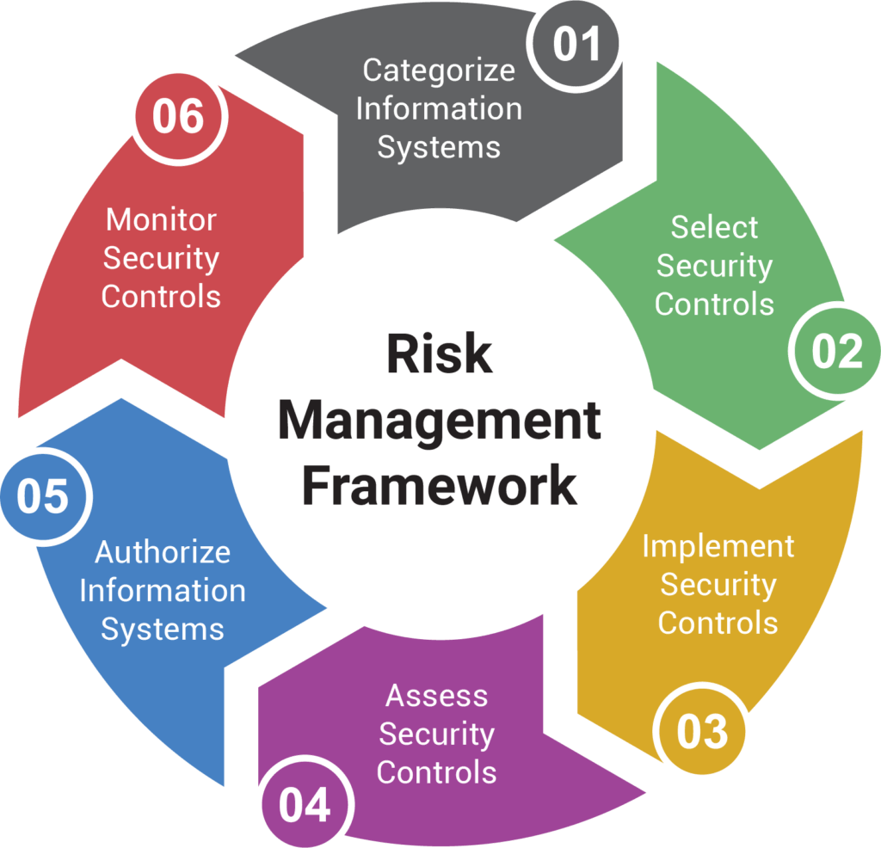

Slide 11
Session 1
1.1 Consult with stakeholders to determine scope of risk management appropriate to organisation and industry

Slide 12
Risk Management Scoping
Scoping is the part of project planning that involves determining and documenting a list of specific goals, deliverables, features, functions, tasks, deadlines, and ultimately costs.
In other words, it is what needs to be achieved and the work that must be done to deliver a project
Consulting stakeholders and applying the scoping process will allow you to accurately determine the scope of the risk management process.

Slide 13
Risk Management Scoping processes
Identify the project needs.
Confirm the objectives and goals.
Describe the scope.
Expectations and acceptance.
Identify constraints
Identify necessary changes

Slide 14
1. Identify the project needs
When you are able to clearly identify the needs of a risk management, you are more likely to set a sound benchmark from the beginning.
Understanding the ‘what and why’ of a project will enable you to set specific goals and objectives.
It also sets the groundwork for what tasks are to follow and how they are to be performed.

Slide 15
2. Confirm the objectives and goals of the Project
The basis of the scope should entail your goals and objectives to be one that follows a SMART guideline. That is, to be Specific, Measurable and Achievable. It should also be Realistic and completed within a specific Timeframe.
Specific–This involves stating accurately what the risk management process wants to achieve. That is, what, why and how these will be done. Clarity will reduce the chances of ambiguities and misunderstandings.
Measurable –Are your goals and objectives able to provide feedback and be accountable for?
Achievable –Can your goals and objectives be achieved, given the resources on hand?
Realistic –Are the goals and objectives easy to deliver, especially if you face problems or complications. Will these reduce the overall quality of the risk management outcome and cause running over budget and not meeting the set deadlines.
Time Frame –Can your goals and objectives be met within the allocated time frame? Is it a key criterion to meet these deadlines?

Slide 16
3. Describe the scope
The description of the scope should be clear and concise. This allows others in the team to understand what the scope involves.
This includes describing the values and features of risk management. Provide a list which explains the important criteria that allows risk management to be successful.

Slide 17
4. Expectations and acceptance
Successful projects are ones that take into account the value provided to the stakeholders at the end of it. Whether they meet the end-users expectations and accept the outcome and process. The stakeholders will be anyone exposed to the cyber security risks.
Successful risk management processes will achieve the objective of reducing residual risk to an acceptable level for the organization.

Slide 18
5. Identify constraints
There are always roadblocks to achieving what you were set out to do. When being aware of possible limitations along the way, it can help you minimize problems that may delay or constrain your ability to achieve your risk management outcome.
These can be caused by dynamic environmental conditions (internal and external), technological glitches and/or lack of resources. Communicating such problems with your team early on and taking steps to overcome these hurdles will reduce delays in project completion and keep spending within budget.
Whether these are based on assumptions or uncertainty, analyzing their impact throughout the projects timeline further reduces the risk of failure.

Slide 19
6. Identify necessary changes
It is always best to avoid reworking the scope, as it means investing in more time, money and resources.
However, at times these changes are inevitable and necessary.
Limit changes by taking on the perspectives of customers, stakeholders, and employees involved in the project. This minimizes disagreements later on.
Simulate, role play or brainstorm with the team, potential changes that may occur and their impact to the risk management process.

Slide 20
Questions?

